Slide 1
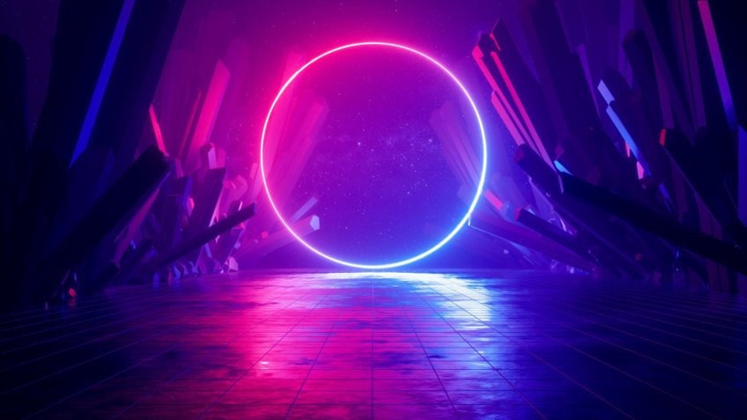
Project Quiz game
Muhammad
Shaheer
Made by
Muhammad
Anas

Slide 2
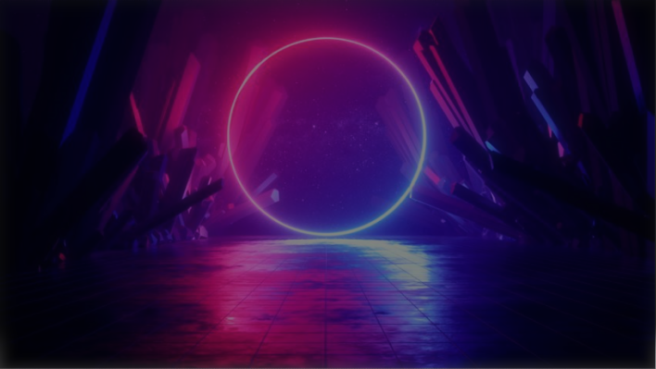
CONTENTS
Introduction
System Model
Result
Future Work

Slide 3
Introduction
We have developed this game to ask users some general IQ-based questions to calculate his/her IQ. This will help the user to find out his IQ level through this game. This system will also keep track of the players who have played this game. This game will contain different levels of difficulty which are:
LEVEL 1(EASY)
LEVEL 2(NORMAL)
LEVEL 3(HARD)
This project is aimed to build a fully functional game to achieve the efficiency of a Quiz Game and will help users to improve his/her IQ in the end of the game the user will find out his/her IQ level and standing with the track of the score.

Slide 4
System model
Initially, the program will ask the user to enter player's name and then whether he must play a normal quiz game or wants to play an IQ game.
Quiz game
5 lives to complete the game
3 Levels: 1 point for LEVEL1, 2 for LEVEL 2 and so on.
In the end overall score of player will be displayed.
IQ game
No life count will be available in IQ game.
The user has to choose right answers
At the end of the program IQ percentage will be shown and
An IQ standing for e.g. (EXCELLENT/FAIR/POOR).

Slide 5
Results
All level questions were compiled in one single program where the user was given a choice to either play a Quiz game or an IQ game.
Data members according to the function were made which were used throughout the program.
The program is built to meet all the basic functionalities of a normal quiz game and an IQ game where the user can find his/her IQ percentage and standing.
The players who will play the game their names will be append to the file.
Some sample outputs are attached.

Slide 6

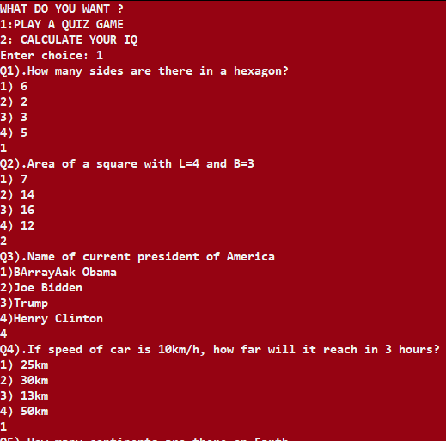
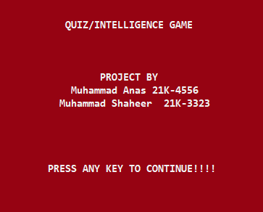
Main screen
Level Questions

Slide 7
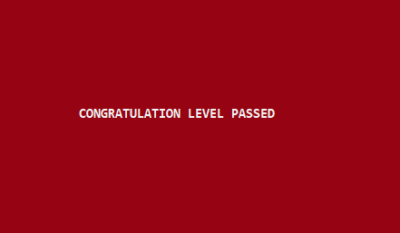
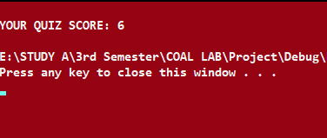
Reward message
After passing a level only on good score you can move on to next level
And after successfully completing a level, this screen appears.
Score
The Score is printed once all levels are completed or if you immediately lose.

Slide 8
Future Work
In the future we want to add more modifications on this program by making it more efficient by using some efficient algorithms, adding time complexity, and adding a random function to display the questions randomly along with multiplayer functionality in which two users play game one by one and then we compare their IQ’s based on their separate answers.

Slide 9
Thank you

